Slide 1
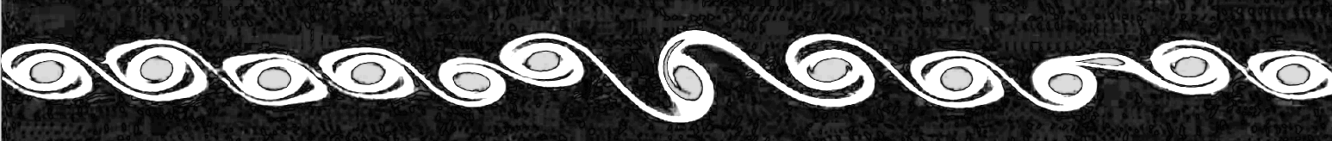
Simulation of Kelvin-Helmholtz instabilities using a lattice-Boltzmann method
Thomas Rothe / Vincent Krabbenborg
19 May 2022
Computational Physics ‘22

Slide 2
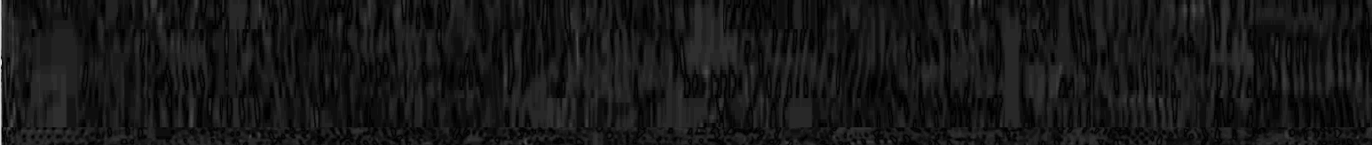
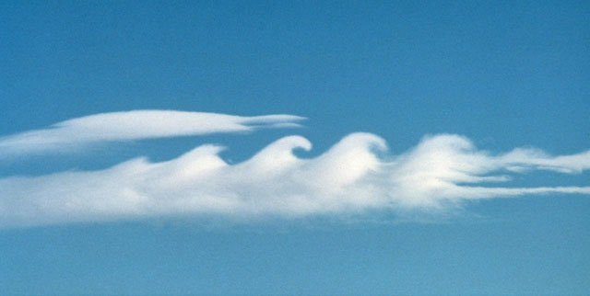
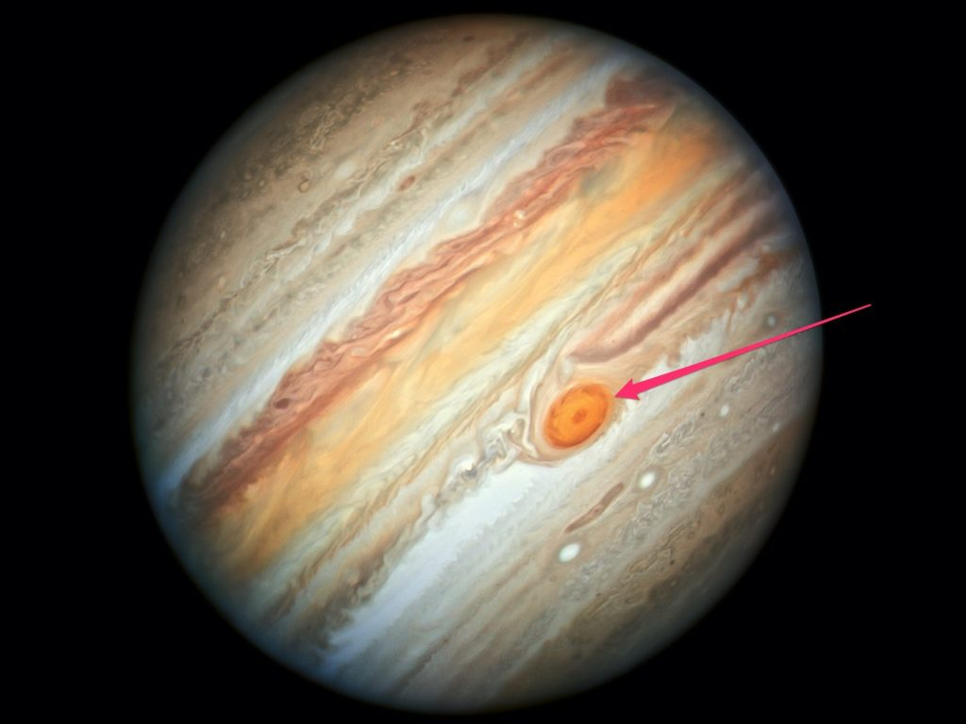
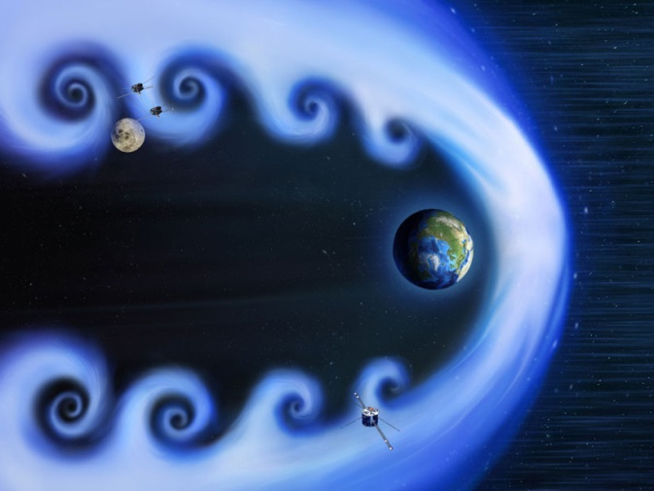
Introduction
[1]
[2]
[3]
[1]: https://www.researchgate.net/figure/The-Kelvin-Helmholtz-instability-is-visible-by-clouds-Source-Brooks-Martner-NOAA-ETL_fig9_279953803
[2]: https://www.businessinsider.nl/nasas-hubble-space-telescope-detected-mysterious-changes-in-jupiters-great-red-spot/
[3]: https://eos.org/research-spotlights/measurements-of-kelvin-helmholtz-waves-in-earths-magnetic-field

Slide 3
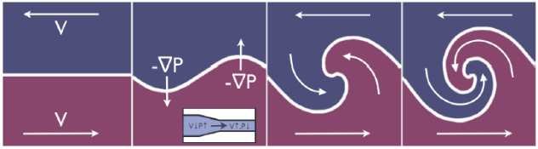
Theory: Kelvin-Helmholtz instabilities
[4]
[4]: https://gilly.space/Kelvin.html

Slide 4

Theory: Kelvin-Helmholtz instabilities
- Shearing force VS buoyancy force:
$$R_{i}=\frac{buoyancy}{shear}=\frac{N^{2}}{U^{2}}$$
$N=\sqrt{−\frac{g}{ρ}\frac{dρ}{dz}}$ , $U= \frac{1}{2}\left(U_{2}−U_{1}\right)$

Slide 5

Theory: Kelvin-Helmholtz instabilities
- Shearing force VS buoyancy force:
Using the Taylor-Goldstein equation one can deduce:
$$R_{i}>\frac{1}{4} →laminar$$
$$R_{i}<\frac{1}{4} →turbulent$$
Why ¼ and not 1?

Slide 6
Theory: Fluid dynamics
3
Cacuhy Momentum Equation:
Mass and (total) momentum conservation:
+ energy conservation + other assumptions …

Slide 7
Theory: Fluid dynamics
3
Navier-Stokes equations:
Divergence of stress
Convection
Diffusion
Dynamic Viscosity:

Slide 8
Theory: The Boltzmann Equation
3
Boltzmann equation:
Particle Number Density:
Bhatnagar-Gross-Krook: (BGK)
With equilibrium density:

Slide 9
Theory: Physical quantities
4
Ideal gas

Slide 10
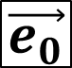
Theory: D2Q9 Discrete lattice model
4
r
$$\vec{e_{0}}$$

Slide 11

Theory: lattice-Boltzmann Equation (LBE)
4
r
r
r
r
r
r
r
r
r
r
r
$$r$$
r
r
r
r
r
r
r
r
r
r
Theory: lattice-Boltzmann Equation (LBE)

Slide 12
Theory: D2Q16 Discrete lattice model
4
r

Slide 13
Theory: lattice-Boltzmann Model (LBM)
4
time
Collision + Advection:

Slide 14
Moment space and the LBM
4
0th moment
Density
1st moment
Momentum density
Conserved
Kinetic energy density ~ Pressure
Viscous Stress tensor
Energy flux

Slide 15
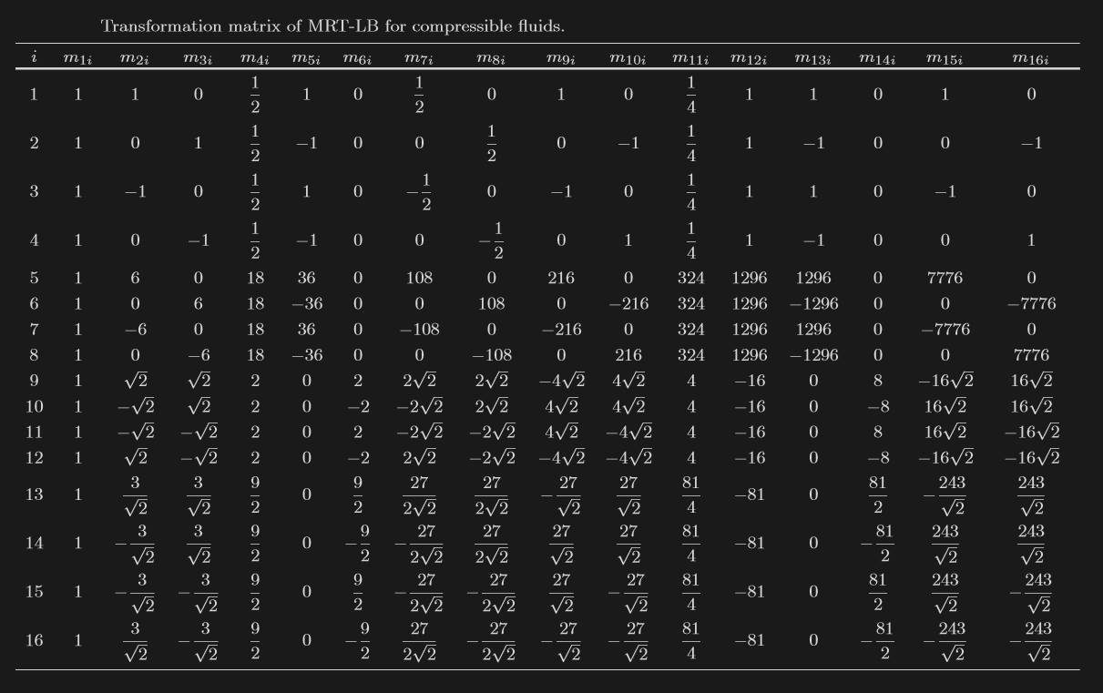
Moment space and the LBM
4

Slide 16
Theory: Moment space and the LBM
4
with relaxation matrix:
BGK

Slide 17
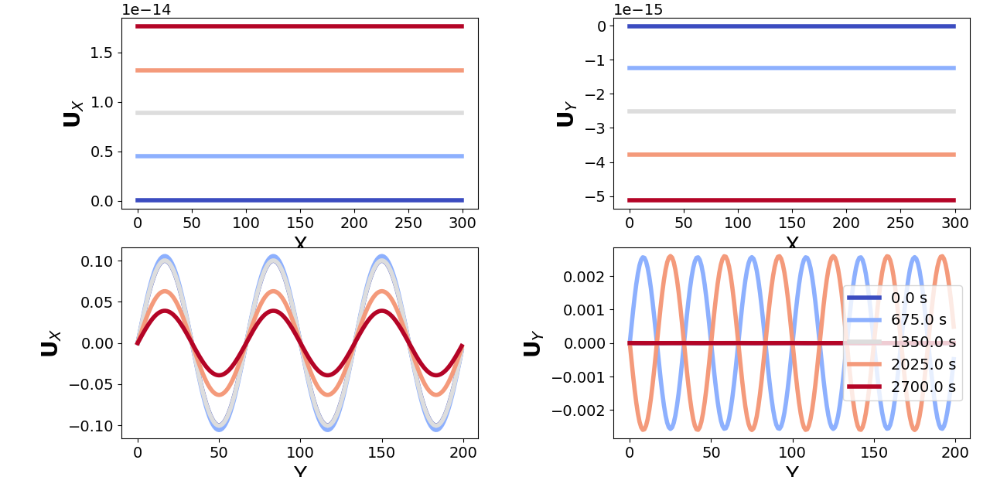

Results: Periodic perturbation
$$\left(w=600, h=600\right)$$

Slide 18
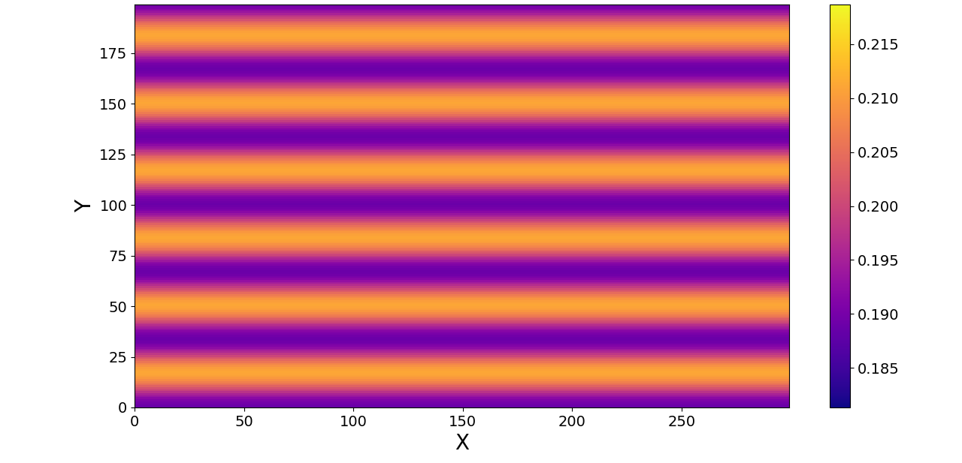
Results: Mixing
$$\left(w=600, h=600\right)$$
Pressure wave:

Slide 19
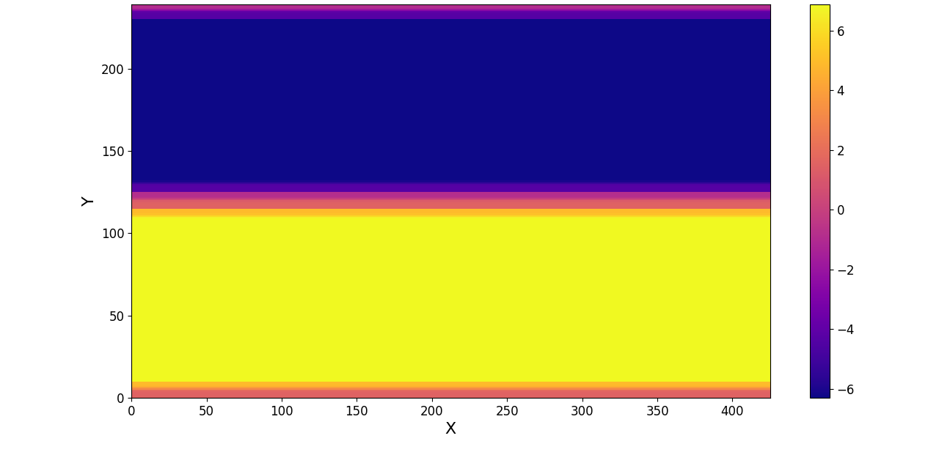

Results: Mixing
$$\left(w=600, h=600\right)$$

Slide 20
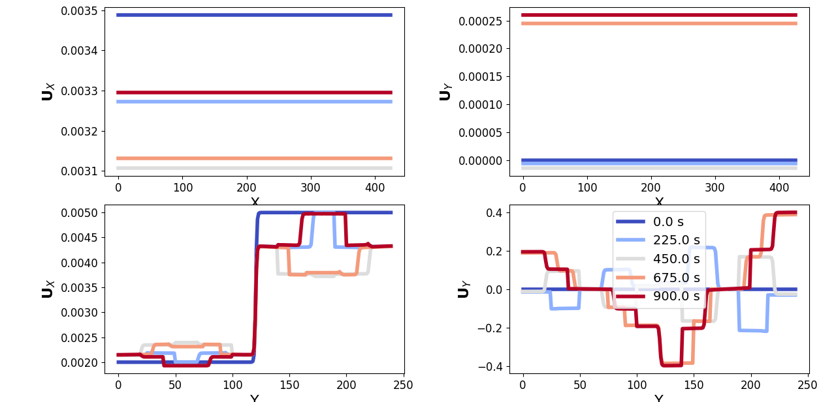
Results: Míxing
$$\left(w=600, h=600\right)$$

Slide 21
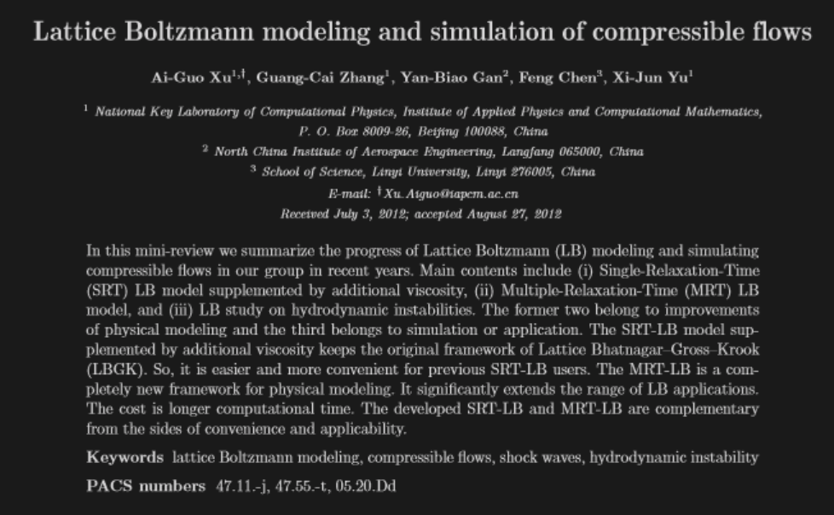
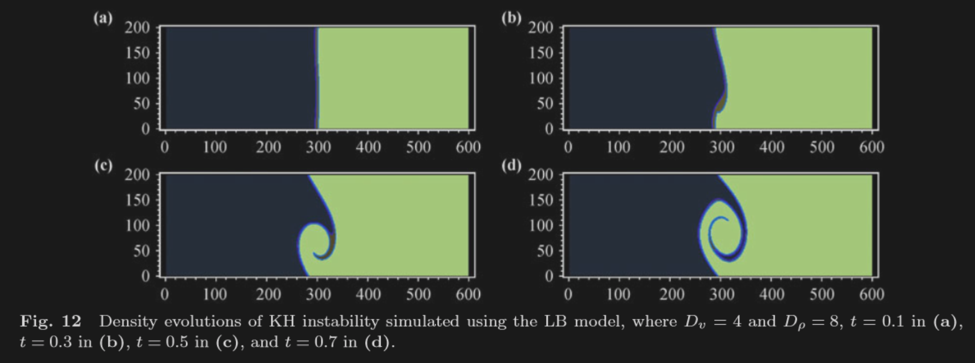
Results
[ 4 ]

Slide 22


Results
D2Q16-lattice:
$$\left(w=600, h=500\right)$$
D2Q16-lattice:
$$\left(w=600, h=600\right)$$
+ perturbation:

Slide 23
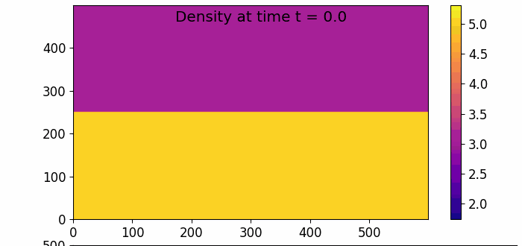
Results

Slide 24
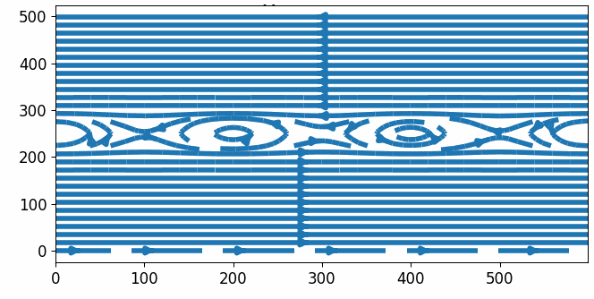
Results

Slide 25
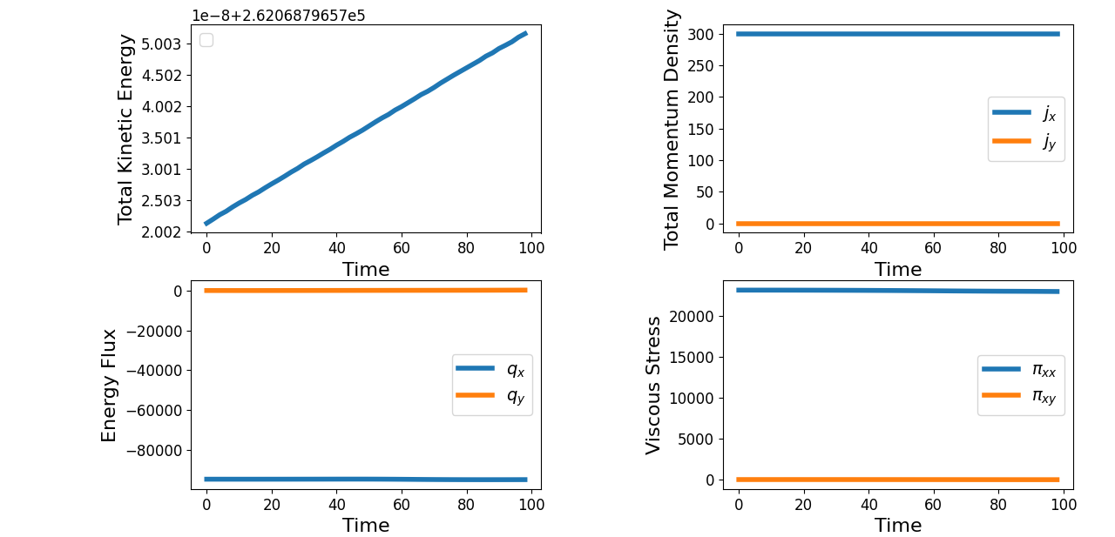
Results

Slide 26
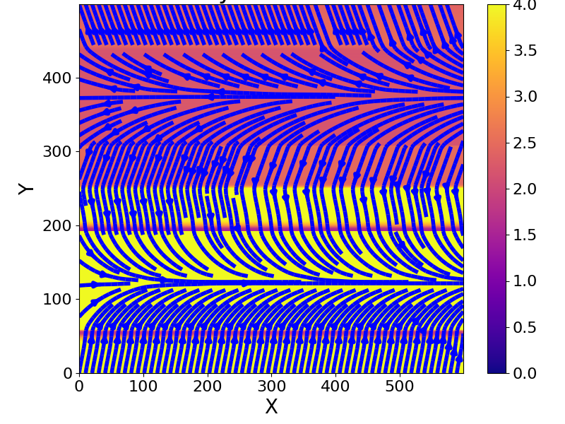
Results
Semi-stable…

Slide 27
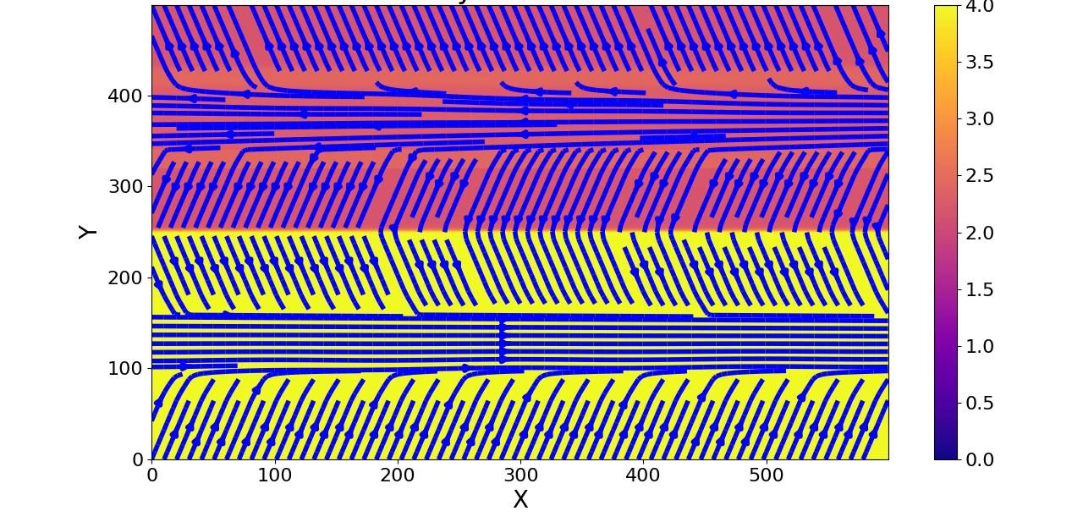
Results
Stable…

Slide 28

Simulation of Kelvin-Helmholtz instabilities using a lattice-Boltzmann method
Thomas Rothe
Vincent Krabbenborg
github.com/Vinnert/Computational-Physics

Slide 29
References
[ 1 ] Chapter 14 of J.M. Thijssen (2007), Computational physics, Cambridge University Press
[ 2 ] P. Lallemand & L.S. Luo (2000), Theory of the lattice Boltzmann method: Dispersion, dissipation, isotropy, Galilean invariance, and stability, Physical Review E, 6 (61), 6546-6562,
[ 3 ] M. Barbulescu & Erdélyi (2018), Magnetoacoustic Waves and the Kelvin–Helmholtz Instability in a Steady Asymmetric Slab: I: The Effects of Varying Density Ratios,
Solar Physics. 293
[ 4 ] A.G. Xu et al (2012), Lattice Boltzmann modeling and simulation of compressible flows, Front. Phys., 2012, 7(5): 582–600

